Slide 1
PROJETO
Mês, ano
Privado e Confidencial

Slide 2
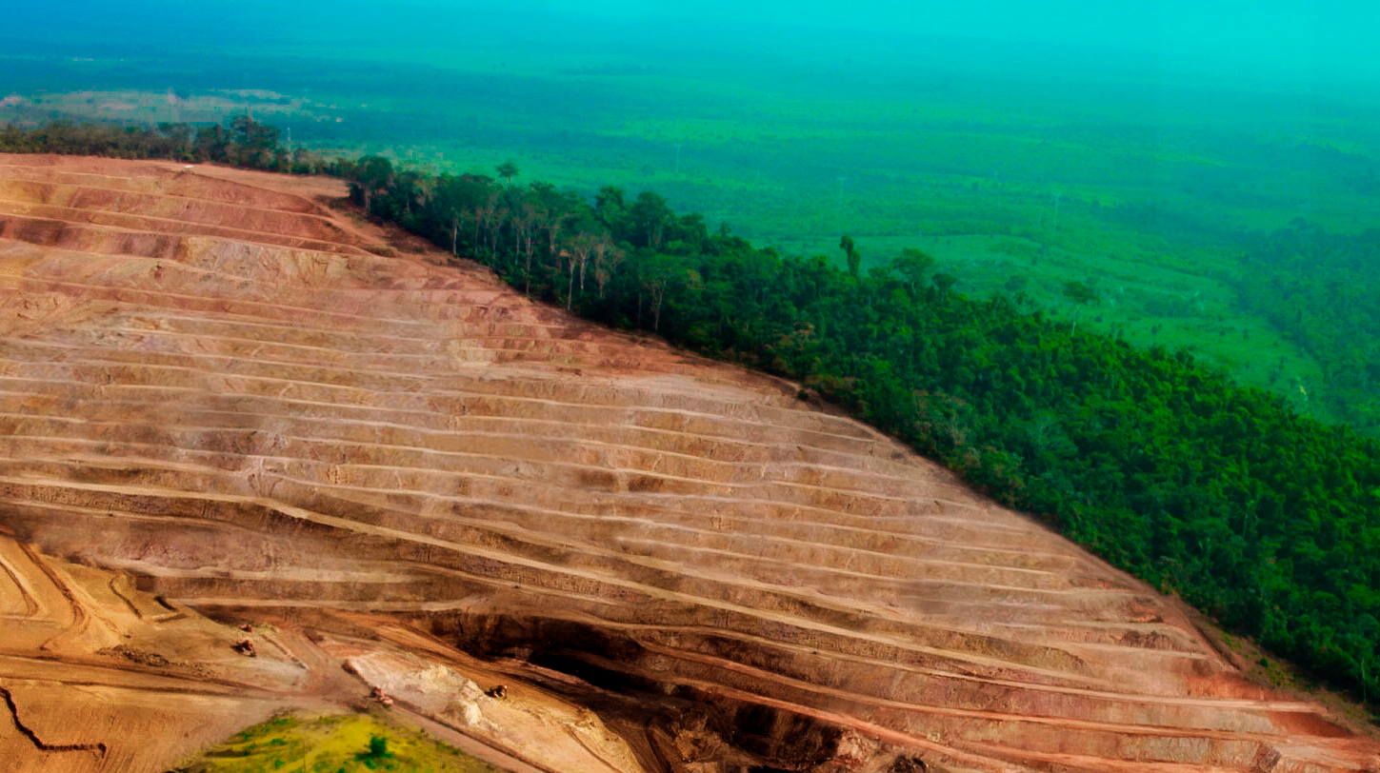

AGENDA
05
EXECUTIVE SUMMARY
07
BURITIRAMA AT A GLANCE
08
BURITIRAMA’S TIMELINE AND FINANCIAL FIGURES
10
DEAL STRUCTURE
12
R2C TEAM ENGAGED IN THE DEAL
13
WHY ENGAGE WITH R2C?
14
TERMS & CONDITIONS
16
LIQUIDATION IN BANKRUPTCY PROCEEDINGS SUMMARY
19
LIQUIDATION IN BANKRUPTCY PROCEEDINGS TIMELINE
22
JOÃO ARAÚJO’S ASSETS
23
STRONG INDICATIONS OF FRAUD AND ASSET CONCEALMENT
24
LAWSUITS AGAINST BURITIRAMA
26
BALANCE SHEET
27
2023 BALANCE SHEET
28
INCOME STATEMENT
29
CASH FLOW
Manganese Opportunity in Brazil | Agenda | September, 2023

Slide 3
EXECUTIVE SUMMARY

Slide 4
TÍTULO
SUBTÍTULO
TÍTULO | TÍTULO | Mês, Ano

Slide 5
DEAL STRUCTURE

Slide 6
DEAL STRUCTURE
R2C CAN PROVIDE AN IDEAL ENVIRONMENT FOR GLENCORE TO ACQUIRE BURITIRAMA’S MANGANESE ASSET AT A FAVORABLE DISCOUNT
R2C NEGOTIATES WITH CREDITORS & LIQUIDATOR
1
INVESTMENT VEHICLE STRUCTURING
3
DILIGENCE & VALUATION
5
R2C will establish an investment vehicle, such as a Private Equity Investment Fund ("PEIF"), which will be capitalized by GLENCORE upon asset acquisition. This structure ensures that R2C negotiates with the creditors throughout the entirety of the due diligence, negotiation, and acquisition process, thereby securing enhanced bargaining leverage.
R2C will support GLENCORE in the due diligence process, ensuring that Buritirama's valuation accurately reflects the actual state of the manganese assets and remains competitive, considering operational costs and necessary CAPEX. The investment vehicle will remain active within the legal context, safeguarding its interests, while R2C provides GLENCORE with daily updates on the progress of the judicial proceedings.
R2C will work to secure the maximum possible discount from the target price set by GLENCORE, negotiating with the creditors to establish a favorable competitive structure and a reasonable minimum price aligned with GLENCORE’s guidelines.
DECLARATION OF INTEREST IN BURITIRAMA’S ASSETS
GLENCORE SETS THE TARGET PRICE FOR THE MANGANESE ASSETS
INVESTMENT VEHICLE BIDS ON ASSETS
2
4
6
The investment vehicle will formally request within the liquidation bankruptcy proceedings its interest in acquiring Buritirama's manganese assets. This strategic step not only ensures enhanced creditor support and expedites the legal process but also establishes a more direct engagement with the judicial administrator (with whom R2C maintains a positive rapport), facilitating access to Buritirama's information and manganese reserves. This, in turn, ensures a comprehensive due diligence process.
GLENCORE will establish a target price for the acquisition of the manganese assets that is both competitive within the auction environment and economically appealing for its acquisition strategy.
The investment vehicle managed by R2C will place its bid in the auction for the manganese assets, which will be free of liabilities and encumbrances.
ASSETS ARE TRANSFERED TO GLENCORE
7
The manganese assets are transferred from the investment vehicle to GLENCORE, and the creditors of Buritirama are paid using the proceeds from the auction.
Manganese Opportunity in Brazil | Deal Structure | September, 2023

Slide 7

R2C TEAM ENGAGED IN THE DEAL
R2C specializes in structured solutions for investments, with a focus on acquiring assets in special situations, purchasing securities traded in organized markets, and fostering the growth of businesses without access to credit from the traditional market.
Through the allocation of proprietary resources and/or strategic investor funds, we provide access to non-traditional investment structures aimed at accelerating growth for businesses that have reached high levels of saturation in credit market fundraising.
Likewise, we directly engage in the assessment, acquisition, and management of assets (companies or real estate) that find themselves in special situations (insolvency, legal disputes, corporate conflicts, etc.).
The partners of the R2C Group possess extensive experience in alternative investments, particularly structured products. Our expertise spans involvement in credit assignment operations that surpassed R$ 15 billion (face value) with major banks and retail networks such as HSBC, Panamericano, Santander, Credit Suisse, Pão de Açúcar, Magazine Luiza, Lojas Marisa, among others.
The R2C Group holds an authorized asset management firm regulated by the CVM, which currently manages approximately R$ 800 million.
‘
PHA ADVOGADOS
RENATO MAZZUCCHELLI
PARTNER
RUY DEL GAISO
LEGAL ADVISOR
PARTNER
EXECUTION
DANIEL GRAZIANO, CFA
PARTNER
LUCAS AVELLEDA
ANALYST
LEGAL
STRATEGIC PARTNER
EDUARDO ASPERTI
PARTNER
FEMA INVESTIMENTOS
SARA ALMEIDA
LAWYER
Manganese Opportunity in Brazil | Deal Structure | September, 2023

Slide 8
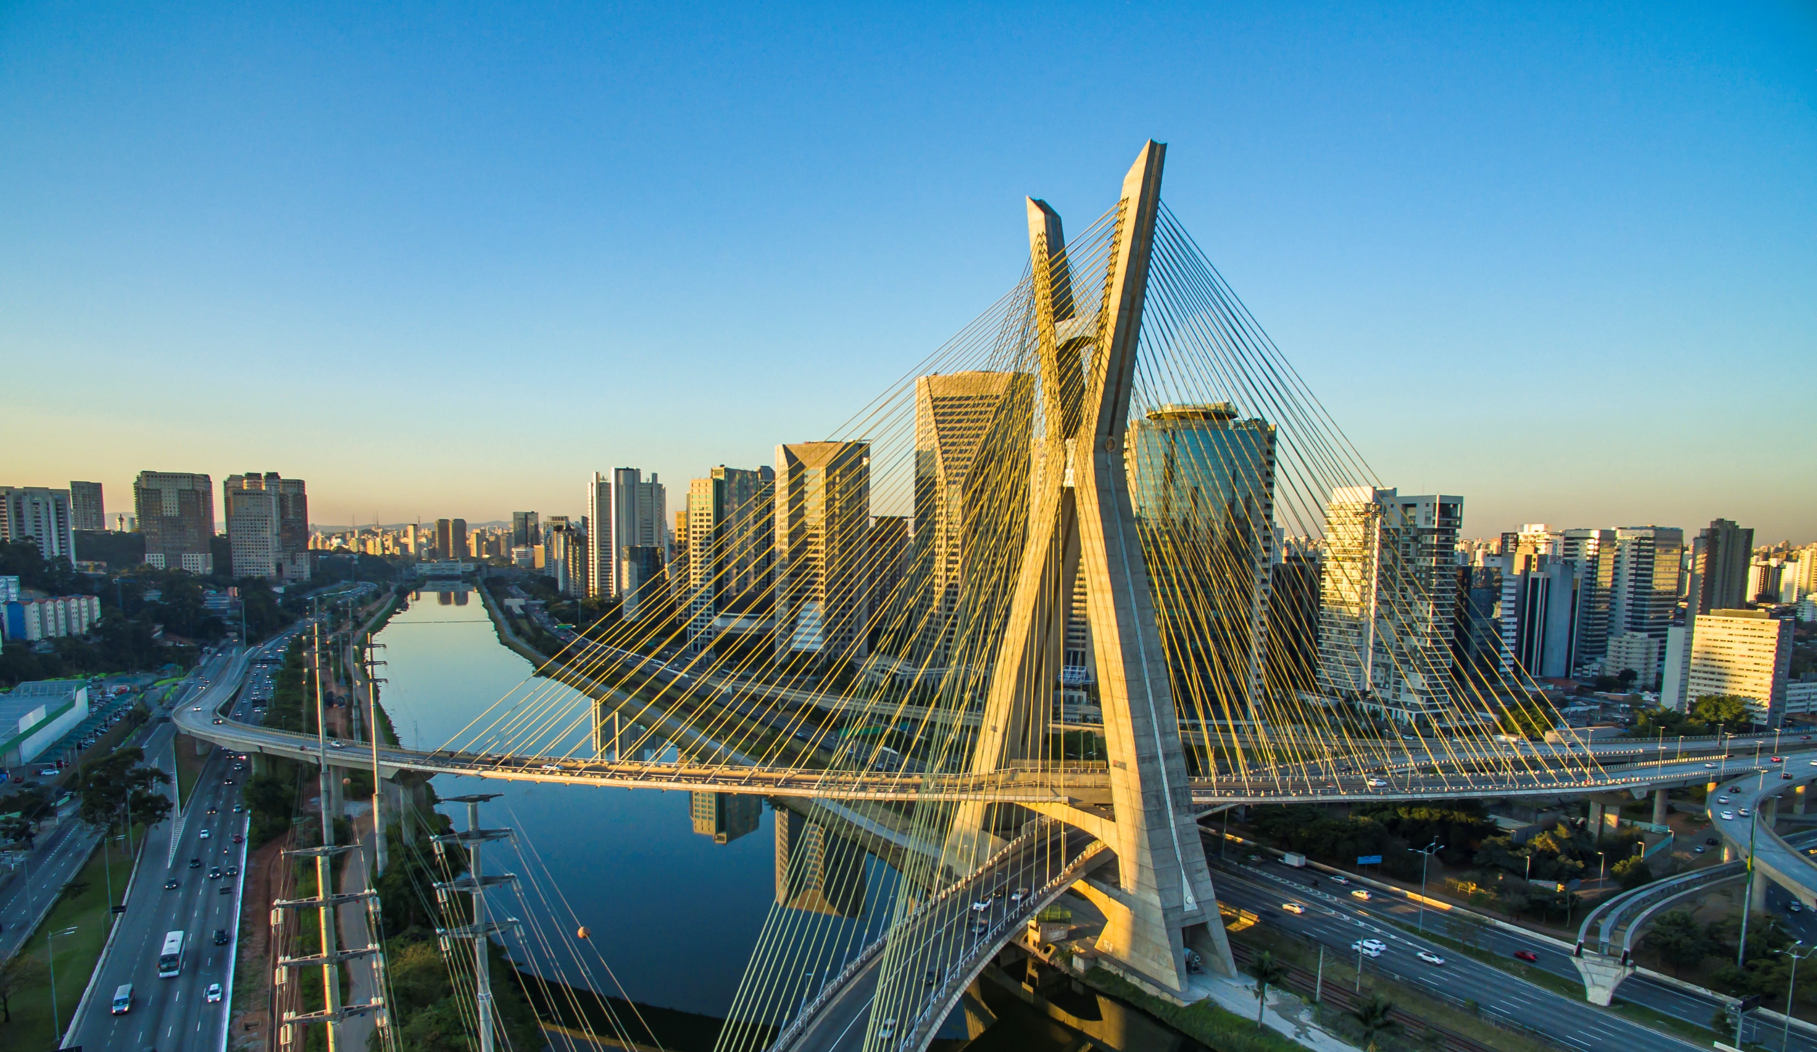
WHY ENGAGE WITH R2C?
R2C’ partners and strategic advisor, FEMA Investimentos, have worked together and built a solid relation with Laspro (Buritirama’s liquidator) in previous transactions. This close relation with Laspro will allow easier access to Buritirama’s data and operating sites.
NETWORK
We have also been in contact with many creditors, suppliers, clients and creditor’s lawyers for the past three years, making it easier to start negotiating the sale of assets to repay all creditors.
R2C partners and FEMA Investimentos gather more than 20 years of expertise in special situations, distressed assets and structured products in operations that surpassed R$ 15 billions.
EXPERTISE
Through the last 3 years following Buritirama’s case we have gathered a significant amount of data and information about João Araújo, his assets and companies that may contribute to a less expensive acquisition of the manganese business units by GLENCORE (i.e: finding potential acquirers to non-related manganese assets in order to develop a single bid on all assets, which creditors would prefer)
INTELLIGENCE
R2C also has a proprietary algorithm to be quickly updated on all lawsuits assigned to São Paulo State Court and will be able do provide GLENCORE with a daily comprehensive update on all lawsuits of our interest (an example of the report is on the “Liquidation in Bankruptcy Proceedings Case Update” section).
R2C’s interests are aligned with GLENCORE’S: enable the acquisition of Buritirama’s manganese assets at the lowest possible price
R2C have partners based both in São Paulo and London, within close reach to GLENCORE’s headquarters in Paris and its São Paulo office
ALIGNMENT
PROXIMITY
Manganese Opportunity in Brazil | Deal Structure | September, 2023

Slide 9
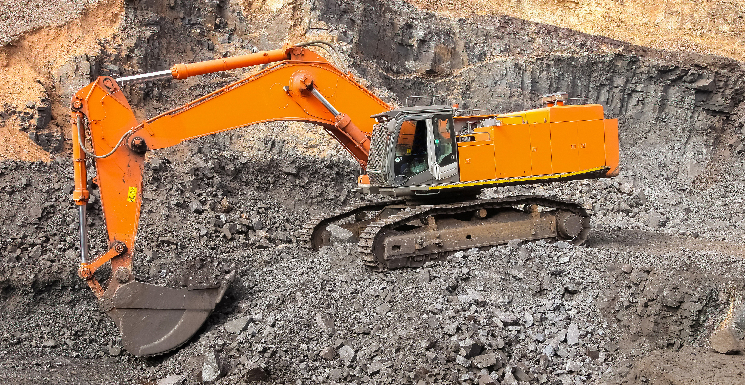
TERMS & CONDITIONS
R2C’S INTEREST ARE ALIGNED WITH GLENCORE’S: MINIMIZE BURITIRAMA’S MANGANESE ASSETS’ ACQUISITION PRICE
The proposed transaction involves the acquisition of Buritirama’s manganese assets through a court-supervised mechanism which delivers the assets to GLENCORE at an agreed price “target price” and free of Buritirama’s existing liabilities;
R2C will negotiate with the liquidator, creditor banks, and other stakeholders a sale or disposition of the manganese assets in terms which are commercially acceptable to GLENCORE;
R2C will structure and manage the investment vehicle that will represent GLENCORE’s interests and will bid on Buritirama’s assets.
SCOPE
R2C will charge a flat fee on the agreed target price and will also be entitled to charge 20% of the savings should the assets be acquired below the target price. The flat fee shall be determined as follows:
5% on the portion of the target value that does not exceed USD 50 million;
4% on the portion of the of the target value between USD 50 million and USD 100 million;
3% on the portion of the target value that exceeds USD 100 million.
R2C will also charge a non-refundable structuring fee of USD 200,000 which will be deducted from the flat fee once the deal is done. USD 100,000 are due after the proposal’s acceptance and the remaining USD 100,000 will be due when the flat price is defined.
R2C’s COMMITMENT
TRANSPARENCY
PROMPTNESS
FEES
DEDICATION
EXECUTION
R2C shall act as the sole facilitator of the Transaction;
GLENCORE hereby undertakes not to contact, negotiate or in any way initiate or cause to be initiated any communication with any Stakeholder, its shareholders, directors, officers, representatives or employees, as well as any of their respective advisors or consultants, with respect to Buritirama or the Targeted Asset;
The deal structure may be subject to changes if Buritirama manages to reverse its liquidation in bankruptcy proceedings into a judicial recovery – which would be unprecedented from the legal point of view.
CONDITIONS
Manganese Opportunity in Brazil | Deal Structure | September, 2023

Slide 10
LIQUIDATION IN BANKRUPTCY PROCEEDINGS CASE UPDATE

Slide 11
LIQUIDATION IN BANKRUPTCY PROCEEDINGS SUMMARY
R2C AND ITS STRATEGIC ADVISOR HAVE A CLOSE RELATION WITH LASPRO, BURITIRAMA’S LIQUIDATOR
CASE DETAILS
PARTIES IN THE LAWSUIT
Number: 1079544-45.2022.8.26.0100
Court: 2nd Bankruptcy and Judicial Recovery Court, Central Civil Forum, São Paulo State Court
Judge: Ralpho Waldo de Barros Monteiro Filho
Filling Date: 07/28/2022
Amount in dispute: BRL 27,242,511.31
Administrator: Laspro
Parties | Type | Attorney
C. Steinweg Handelsveem (Latin America) S.a. | Plaintiff | Ricardo Amorim (CSA)
Mineração Buritirama S/A | Bankrupt | Gustavo Freire da Fonseca (Fonseca Brasil) Brahum Bitar de Sousa (Fonseca Brasil) Fabrício Rocha da Silva (Rocha Baptista) Flavia Moller (Buritirama) Rogério Zampier Nicola (Nicola & Saragossa) Jonathan Camilo Saragossa (Nicola & Saragossa)
Skypar International Inc | Interested party | Sheldon Geraldo de Almeida (Sheldon, Almeida, Teodoro & Oliveira)
Laspro Consultores LTDA | Judicial Administrator | Orestes Nestor de Souza Laspro
Itaú Unibanco S.A. | Creditor | Domingos Fernando Refinetti (WK) Victor Salgado (WK)
Banco Santander Brasil S.A. | Creditor | Gabriel de Orleans e Bragança (SOB)
Citibank N.A. | Creditor | Marcos Cavalcante de Oliveira (Sturzenegger e Cavalcante) Ricardo Chiavegatti (Sturzenegger e Cavalcante) Bruna Processi (Sturzenegger e Cavalcante)
Banco Safra S.A. | Creditor | Carlos Septembero Tortoro Júnior (Tortoro, Madureira & Ragazzi)
CURRENT STATUS
Sentence: Bankruptcy declared on 07/07/2023.
Ongoing Decision: On 18/08/2023, the judge ruled:
Choosing Geribá to assume interim management of Buritirama for a period of three months;
The Judicial Administrator (AJ) to arrange a General Assembly of Shareholders (AGE) to choose the company that will take over the management of Buritirama during the continuation of activities until its complete closure becomes feasible;
Serving notice to Norte Empreendimentos to provide clarification regarding the manganese stocks and shipments of Buritirama.
Buritirama's Instrumental Appeal (AI 01) seeking to reverse the bankruptcy had its suspensive effect denied on 27/07/2023, and on the same date, it was forwarded for processing. The Judicial Administrator and interested parties were summoned to make their statements.
Intentionally Concealed
Intentionally Concealed
Intentionally Concealed
Manganese Opportunity in Brazil | Liquidation in Bankruptcy Proceedings Case Update | September, 2023

Slide 12
LIQUIDATION IN BANKRUPTCY PROCEEDINGS SUMMARY
BURITIRAMA IS CURRENTLY TRYING TO REVERSE THE LIQUIDATION BANKRUPTCY SENTENCE
Parties | Type | Attorney
Banco ABC Brasil S.A. | Creditor | Gustavo Tepedino (Gustavo Tepedino Advogados) Milena Donato Oliva (Gustavo Tepedino Advogados) Renan Soares Cortazio (Gustavo Tepedino Advogados)
Banco Votorantim S.A. | Creditor | Alfredo Migliore (MWF Advogados) Kedma de Moraes Watanabe (MWF Advogados) Rodrigo Poit Bassalobre (MWF Advogados)
ICBC do Brasil Banco Múltiplo S.A. | Creditor | Rodrigo Carlos Pelegrini Silva
Albieri Transporte e Logística LTDA | Creditor | Maria Madalena da Silva
Zalog Operadora Logística LTDA | Creditor | Juliana Lambertucci
Fox Comércio de Lubrificantes LTDA | Creditor | Emanuel Pires das Chagas
R A Machado Restaurante LTDA | Creditor | Ivan Lula de Sousa Junior
Colaboradores Buritirama (filial São Paulo) | Creditor | Cleiton Rodrigues de Souza
Parties | Type | Attorney
Primotech Logística e Serviços LTDA | Creditor | José Luiz Pereira de Souza Júnior
Transportadora de Cargas Fazendão LTDA | Creditor | Raphaell Lemes Braz
Boutique de Carnes Maraba LTDA-ME | Creditor | Renato Ewerton de Melo Pereira Silva
Roberto Luiz de Freitas Campos – ME | Creditor | Murilo Campos Mizzerani
Cooperativa Mista de Caçambeiros e Proprietários de Máquinas de Marabá | Creditor | Wadson Veloso Silva
Swire Shipping Pte. Ltd. | Creditor | Luiz Roberto Leven Siano (Siano & Martins) Fabiana Simões Martins (Siano & Martins) Marcos Simões Martins Filho (Siano & Martins)
Colaboradores Buritirama (filiais Pará) | Creditor | Daniel Rodrigues Cruz
Letroart Comunicação Visual Eireli | Creditor | Letícia Ohanna Grotto Sousa
Terrafacil Serviços de Terrapalnagem LTDA | Creditor | Luciano Almeida
Companhia Docas do Pará | Interested party | Letícia Camara Machado (jurídico CDP)
Intentionally Concealed
Intentionally Concealed
Manganese Opportunity in Brazil | Liquidation in Bankruptcy Proceedings Case Update | September, 2023

Slide 13
LIQUIDATION IN BANKRUPTCY PROCEEDINGS SUMMARY
BURITIRAMA IS CURRENTLY TRYING TO REVERSE THE LIQUIDATION BANKRUPTCY SENTENCE
LIQUIDATION BANKRUPTCY-RELATED LAWSUITS AND APPEALS
Lawsuit/Appeal | Parties | Assignment | Status | Summary
AI 01: INTERLOCUTORY APPEAL 2190172-59.2023.8.26.0000 | Appellant: Mineração Buritirama S/A Appelee C. Steinweg Handelsveem (Latin America) S.a. | 07/25/2023 to the 1st Chamber of Business Law, with Justice Alexandre Lazzarini as the rapporteur. | Suspensive effect denied on 07/27/2023 Forwarded for Processing by Groups and Chambers on 07/27/2023 Parties and interested parties were summoned for statement on 07/27/2023 | Buritirama requests the setting aside of the judgment that declared the company bankrupt and the granting of a suspensive effect until the final resolution of the appeal. The mining company alleges (i) the absence of requirements for the liquidation bankruptcy declaration; (ii) the use of the bankruptcy petition as a coercive measure by Steinweg; (iii) invalid citation and denial of the right to a defense, and (iv) the unquestionable solvency of Buritirama
AIC 01.1: CIVIL INTERNAL APPEAL 2190172-59.2023.8.26.0000 | Appellant: Mineração Buritirama S/A Appelee C. Steinweg Handelsveem (Latin America) S.a. Interested party: Laspro | 08/08/2023 to the 1st Chamber of Business Law, with Justice Alexandre Lazzarini as the rapporteur | Steinweg summoned to provide comments in the case | Buritirama requests reconsideration of the decision of the interlocutory appeal AI 01, which denied the granting of a suspensive effect on the appeal aimed at annulling the bankruptcy of the company. The mining company argues that it filed for judicial recovery, that several suppliers expressed support for reversing the bankruptcy into judicial recovery, and that the protest that led to the filing for bankruptcy is invalid.
RJ 01: JUDICIAL RECOVERY 1101742-42.2023.8.26.0100 | Petitioners: Mineração Buritirama S/A; Buritipar Holding S/A; Fazendas Nacionais Participações LTDA; Skypar Participações e Empreendimentos EIRELI; Eurotech Yachting Management LTDA | 07/27/2023 to the 2nd Bankruptcy and Judicial Recovery Court, Central Civil Forum, Judge Ralpho Waldo de Barros Monteiro Filho | Distributed on 07/27/2023 | Buritirama files for judicial recovery and states that it does not consider itself bankrupt, as the judgment in the liquidation bankruptcy process has not become final, pending the resolution of the interlocutory appeal AI 01. The value of the claim in the judicial recovery process, as informed by the company, is BRL 3.6 billion, and the mining company's net equity at the end of 2022 was negative BRL 1.5 billion.
Intentionally Concealed
Manganese Opportunity in Brazil | Liquidation in Bankruptcy Proceedings Case Update | September, 2023

Slide 14
LIQUIDATION IN BANKRUPTCY PROCEEDINGS TIMELINE
07/28/22
pg. 1
03/28/23
pg. 276
04/19/23
pg. 280
04/27/23
pg. 336
06/09/23
pg. 697
07/07/23
pg. 699
BANKRUPTCY REQUEST
BURITIRAMA IS FINALLY CITED
SKYPAR REQUESTS THE NULLITY OF THE CITATION
BURITIRAMA REQUESTS THE DISMISSAL OF THE BANKRUPTCY PETITION
BURITIRAMA PETITIONS FOR THE SCHEDULING OF A HEARING AND MAKES A PROPOSAL TO STEINWEG
BURITIRAMA’S BANKRUPTCY IS DECLARED
Steinweg requests the declaration of Buritirama's bankruptcy due to the non-payment of a protested promissory note on 07/26/2022, in the amount of USD 5.01 million.
Justice officer notifies the receptionist at Buritirama's building after suspecting that the company was concealing itself to avoid being cited.
Skypar, owner of Buritirama, requests the nullity of the citation.
Intentionally Concealed
Buritirama accuses Steinweg of engaging in predatory litigation and requests the invalidation of the citation.
"Buritirama proposes payment to Steinweg through the assignment of a stack of 70 thousand tons of manganese ore. The proposal is considered 'indecorous' by Steinweg.
LASPRO is appointed as the Judicial Administrator (JA) for the bankruptcy, and the legal term is set at 90 days from the protest date.
Intentionally Concealed
Intentionally Concealed
Intentionally Concealed
07/14/23
pg. 780
07/14/23
pg. 751
07/13/23
pg. 749
07/13/23
pg. 727
07/13/23
pg. 720
SANTANDER REQUESTS THE APPOINTMENT OF A MANAGER FOR BURITIRAMA
ITAÚ MAKES A STATEMENT AGAINST BURITIRAMA
JUSTICE SEIZES THE CARGOES BEING SHIPPED
BURITIRAMA PROPOSES AN EVASIVE DEPOSIT THROUGH A STACK OF MANGANESE
JUDICIAL ADMINISTRATOR REQUESTS THE SEIZURE OF CARGOES BEING SHIPPED BY BURITIRAMA
The bank argues for the evident state of bankruptcy of Buritirama and the legal impossibility of reversing the bankruptcy.
The amounts owed by the recipients of the cargoes must be deposited into a judicial account.
The company requests complete exemption from bankruptcy through a deposit of 70 thousand tons of manganese valued at USD 5 million.
The bank points out the need for an investigation into fraud and the appointment of a manager with experience in mining.
Intentionally Concealed
Intentionally Concealed
Intentionally Concealed
JA becomes aware of two shipments of 55 thousand tons each at the Port of Vila do Conde and requests the seizure of the cargos.
Intentionally Concealed
Intentionally Concealed
07/18/23
pg. 966
07/19/23
pg. 987
07/19/23
pg. 1017
07/20/23
pg. 5030
07/24/23
AI 01 pg. 1
07/24/23
AI 01 pg. 1097
BURITIRAMA FILES A MOTION FOR CLARIFICATION
STEINWEG TAKES A POSITION AGAINST BURITIRAMA’S DEPOSIT
STEINWEG SUGGESTS NAMES FOR BURITIRAMA'S MANAGEMENT
BURITIRAMA’S MOTION FOR CLARIFICATION IS DENIED
BURITIRAMA APPEALS THE BANRUPTCY JUDGMENT
SUSPENSIVE EFFECT IS NOT GRANTED
The company alleges that the citation by publication was invalid, and argues that it is solvent, requesting the reversal of the bankruptcy with suspensive effect.
Steinweg points out that the production volume mentioned by Buritirama in 2023 implies that the mining company should have a turnover of over USD 70 million, but no money circulated in the company's account between April and May.
Steinweg defends the resumption of Buritirama's activities and suggests Wilson Brumer and Ricardo Werneck as interim managers.
The judge states that the bankrupt company did not demonstrate interest or capability to settle the debts, limiting itself to offering a deposit of manganese.
An interlocutory appeal with a request for suspensive effect is filed seeking to reverse the bankruptcy. Buritirama mentions being solvent and argues that the citation in the bankruptcy process was invalid.
During the judgment of the interlocutory appeal seeking the reversal of the bankruptcy, the rapporteur Alexandre Lazzarini does not grant suspensive effect.
Intentionally Concealed
Intentionally Concealed
Intentionally Concealed
Intentionally Concealed
Intentionally Concealed
Manganese Opportunity in Brazil | Liquidation in Bankruptcy Proceedings Case Update | September, 2023

Slide 15
LIQUIDATION IN BANKRUPTCY PROCEEDINGS TIMELINE
24/JUL/23
fls. 5065
07/27/23
RJ 01 pg. 1
08/01/23
RJ 01 pg. 948, 963, 1003
08/03/23
pgs. 5257, 5270, 5288, 5294
08/03/23
pg. 5364
08/03/23
AI 01 pg. 1114
JUDICIAL ADMINISTRATOR PRESENTS MANAGEMENT PROPOSALS FOR THE COMPANY
BURITIRAMA FILES FOR JUDICIAL RECOVERY
CITIBANK, ITAÚ, AND SANTANDER REQUEST THE TERMINATION OF THE JUDICIAL RECOVERY
SUPPLIERS AND EMPLOYEES OF BURITIRAMA EXPRESS OPPOSITION TO BANKRUPTCY
STEINWEG REQUESTS TO TEMPORARILY ASSUME MANAGEMENT OF BURITIRAMA
BURITIRAMA REQUESTS RECONSIDERATION OF THE DECISION THAT DID NOT GRANT A SUSPENSIVE EFFECT IN AI 01
Buritirama, Buritipar, Skypar, Fazendas Nacionais, and Eurotech file for judicial recovery, arguing that the bankruptcy has not become final. The request will be judged by the same judge who decreed the bankruptcy.
Creditors argue that the company is bankrupt, has provided incomplete documentation, and that there is no legal and economic possibility for the judicial recovery of the other companies in the group.
Albieri Transportes, Zalog Operadora, Fox Comércio, and 6 employees of Buritirama file a petition in favor of reversing the bankruptcy and granting the judicial recovery.
Steinweg stated to have received offers from clients willing to make advance payments to acquire manganese, and that they can take over management while a specialized manager is not chosen by the creditors.
G5 Partners, Geribá Investimentos, Íntegra Associados, Mapa Capital, and RK Partners have submitted proposals to the Judicial Administrator.
Intentionally Concealed
Intentionally Concealed
Buritirama cites an omission in the decision, mentions that filed request for judicial recovery and the suppliers' expressions of support for the mining company.
Intentionally Concealed
Intentionally Concealed
Intentionally Concealed
Intentionally Concealed
08/18/23
pg. 5790
08/18/23
AI 01 pg. 1220
08/10/23
pg. 5414
08/08/23
AI 01 pg. 1194
08/08/23
AI 01 pg. 1198
THE JUDGE DESIGNATES GERIBÁ AS THE INTERIM MANAGER OF BURITIRAMA FOR 3 MONTHS AND REQUESTS A GENERAL ASSEMBLY OF SHAREHOLDERS TO DETERMINE THE PERMANENT MANAGER
SANTANDER SUBMITS COUNTERARGUMENT IN THE APPEAL THROUGH WHICH BURITIRAMA SEEKS TO REVERSE BANKRUPTCY
ITAÚ EXPRESSES OPPOSITION TO THE PETITIONS OF SUPPLIERS AND EMPLOYEES
ICBC BANK PETITIONS IN APPEAL AI 01 REQUESTING THE REVERSAL OF THE BANKRUPTCY
BANKRUPTCY ESTATE OF BURITIRAMA REQUESTS THE UPHOLDING OF THE JUDGMENT THAT DECLARED BANKRUPTCY
The bank cites identical wording among petitions and states that they are just another strategy by Buritirama to disrupt the proceedings.
ICBC, as the primary financial creditor of Buritirama, is the first to express support for the reversal of the bankruptcy. The total ICBC credit is BRL 52 million.
Bankruptcy estate, represented by Laspro, petitions in the appeal opposing the maintenance of the judgment that declared the mining company's bankruptcy.
The bank presents an argumentation along the same lines as Steinweg
Intentionally Concealed
Intentionally Concealed
Intentionally Concealed
Intentionally Concealed
It was also decided to summon Norte Empreendimentos to clarify the shipment schedule and inventory of Buritirama.
Intentionally Concealed
08/23/23
pg. 5853 and 5977
08/25/23
pg. 6019
PRIMOTECH AND BURITIRAMA EMPLOYEES EXPRESS OPPOSITION TO GERIBÁ
LIQUIDATOR REQUESTS INSPECTION ORDER AND POTENTIAL SEALING OF THE MINE
Supplier of Buritirama points out Geribá's lack of mining experience, its minimal share capital, the existence of lower-value proposals, and the relationship between companies in Geribá's group and Santander Bank.
Laspro requests (i) information about mining rights, (ii) freezing of Buritirama's movable assets, and (iii) inspection and potential sealing of Buritirama's mines in order to proceed with the process of collecting these assets.
Intentionally Concealed
Intentionally Concealed
Manganese Opportunity in Brazil | Liquidation in Bankruptcy Proceedings Case Update | September, 2023

Slide 16
STRATEGIC DATA

Slide 17
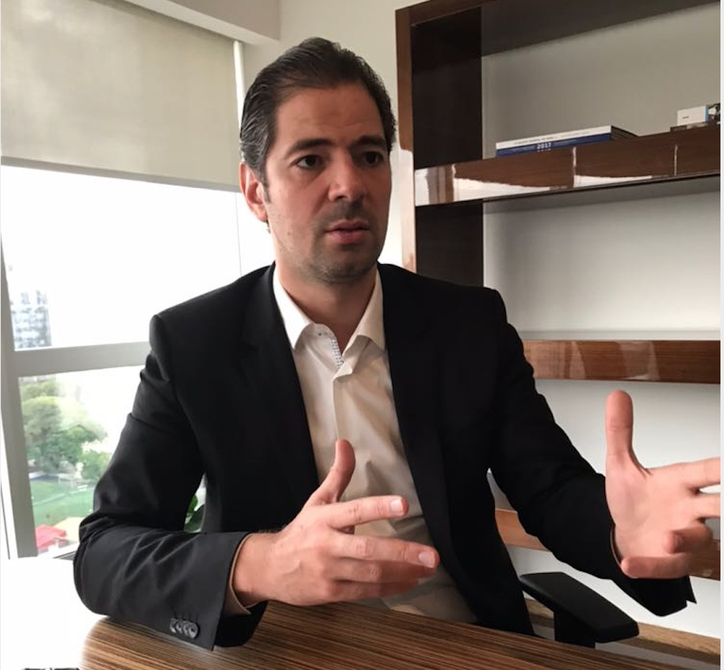
JOÃO ARAÚJO’S ASSETS
R2C MAPPED JOÃO ARAÚJO’S ASSETS AND THEIR POTENTIAL ACQUIRERS
REAL ESTATE
VEHICLES
WORKS OF ART
CHECKING ACCOUNT
ALPARGATAS
ITAUSA
Intentionally Concealed
BRL 11,208,077
BRL 359,323
BRL 2,145,166
BRL 2,215,000
BRL 5,302,835
BRL 120,328
ARAÚJO’S DEBTS
OTHER ASSETS
Intentionally Concealed
Intentionally Concealed
João Araújo
Eurotech Yachting EIRELI
Intentionally Concealed
Skypar Empreendimentos
Skypar International
NEXON
São Paulo Guanabara LTDA
J.D.O. do Brasil Empr. e Part.
Teatro J. Dom. De Araújo
AVANTI BR
Barco “Eike”
3 Terrenos no Rio de Janeiro, Av. Rodrigues Alves, total ~5.1km², matrículas 32.234, 32.235, 32.236
Diversos imóveis em Campos do Jordão e São Paulo
Intentionally Concealed
Buritirama
Fazendas Nacionais
Intentionally Concealed
Buritipar Holding
Kalium
Rio Manganês
Glamurama
Intentionally Concealed
Terreno Osasco
Green Way I FIDC
Buritibeta
Nexon Mineração
Avanti BR
Paranapanema
Manganese Opportunity in Brazil | Strategic Data | September, 2023

Slide 18
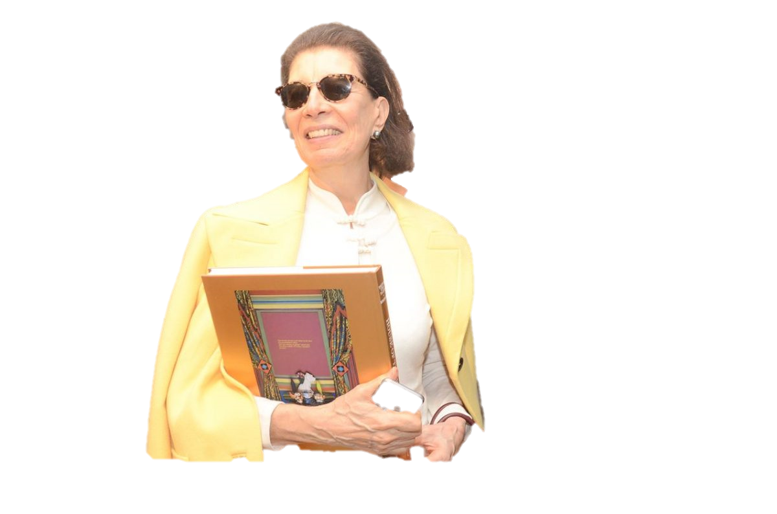
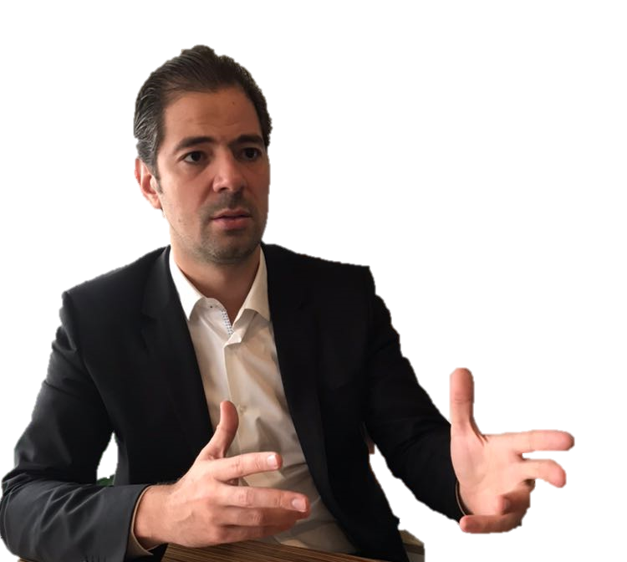

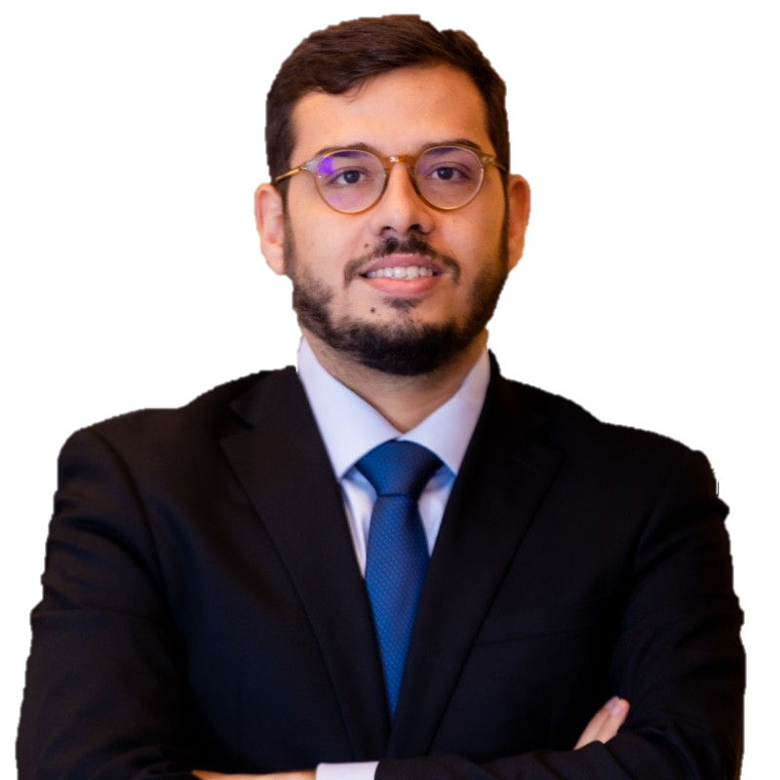

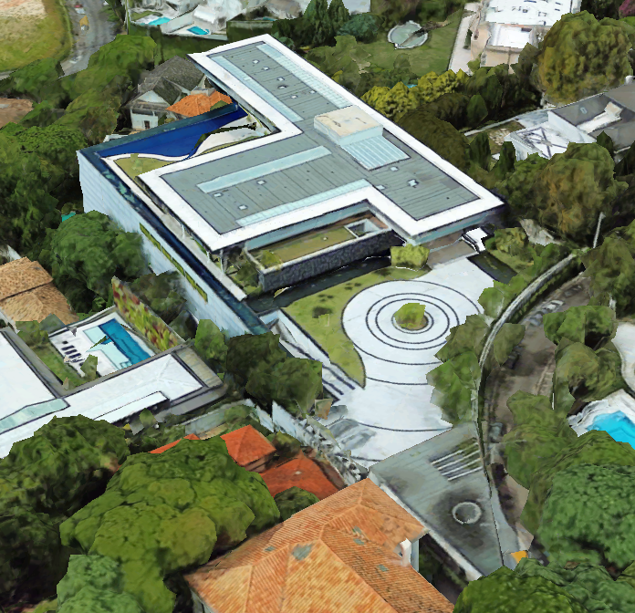

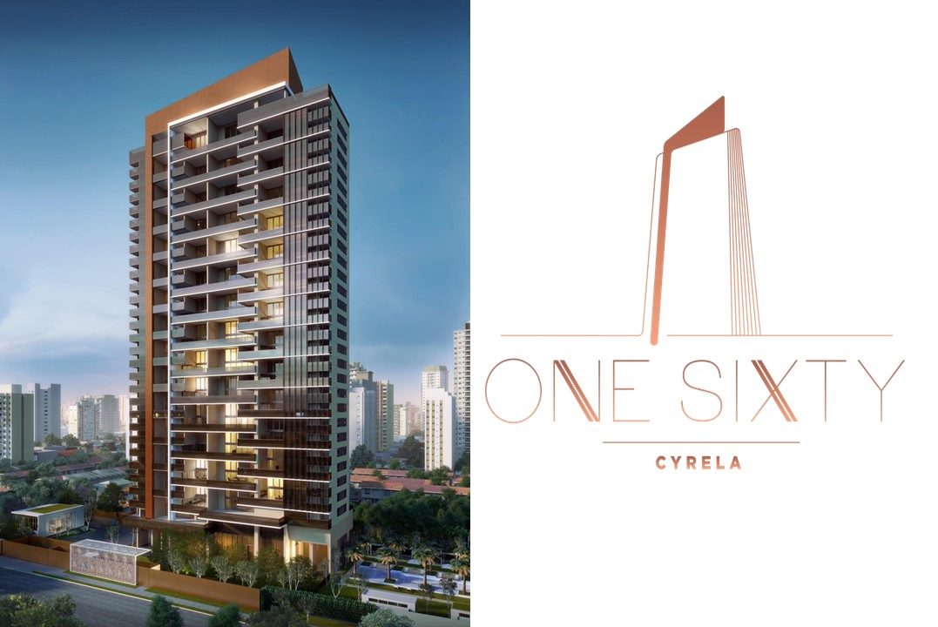
STRONG INDICATIONS OF FRAUD SCHEMES AND ASSET CONCEALMENT
STRATEGIC INFORMATION THAT CAN BE USED TO REINFORCE THE NEED TO KEEP JOÃO ARAÚJO AWAY FROM BURITIRAMA
BRL XX,XXX,XXX
MARIA ZILDA, MÃE DE JOÃO
BRL XX,XXX,XXX
LORENA BENTES
JOÃO ARAÚJO
BRL XX,XXX,XXX
GUSTAVO FONSECA
BRL XX,XXX,XXX
BRL X,XXX,XXX
BRL X,XXX,XXX
XXXXX XXXX
Manganese Opportunity in Brazil | Strategic Data | September, 2023

Slide 19


STRONG INDICATIONS OF FRAUD SCHEMES AND ASSET CONCEALMENT
STRATEGIC INFORMATION THAT CAN BE USED TO REINFORCE THE NEED TO KEEP JOÃO ARAÚJO AWAY FROM BURITIRAMA
ONE SIXTY BY CYRELLA
MARIA ZILDA, MÃE DE JOÃO
DANIEL RESIDIU EM UM APARTAMENTO QUE ERA DE JOÃO ARAÚJO E QUE TEVE ORDEM DE DESPEJO
JOÃO ARAÚJO
JOÃO ARAÚJO
R$ 2,125,131
DANIEL DEMICHELLI
R$ 2,125,131
GUSTAVO FONSECA
LORENA BENTES
DIRETOR “SEM DESIGNAÇÃO ESPECÍFICA”
Manganese Opportunity in Brazil | Strategic Data | September, 2023

Slide 20
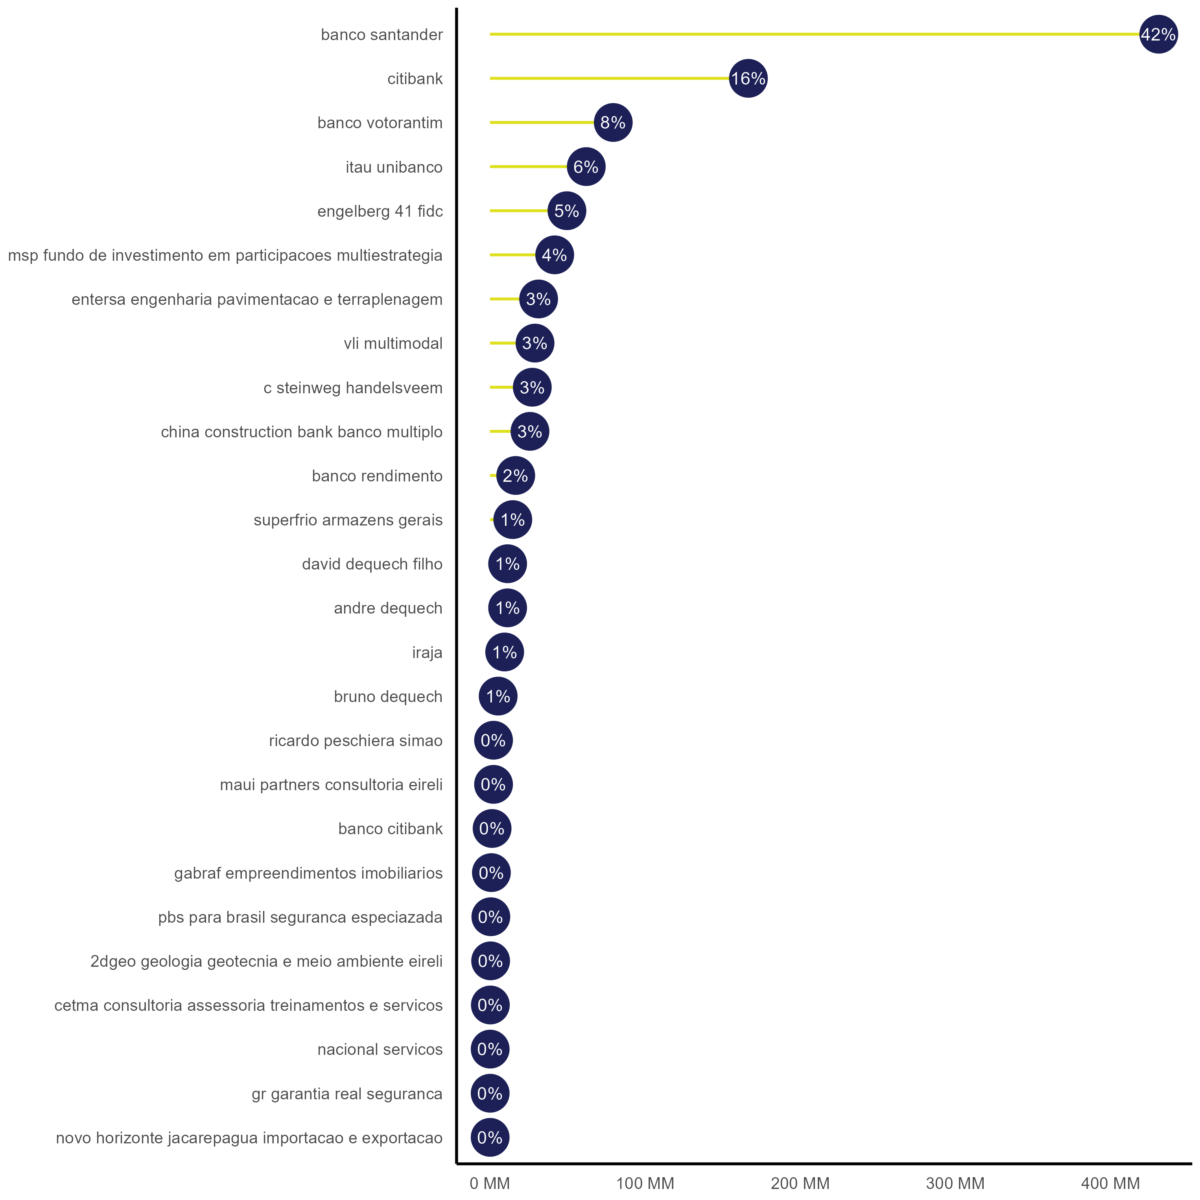

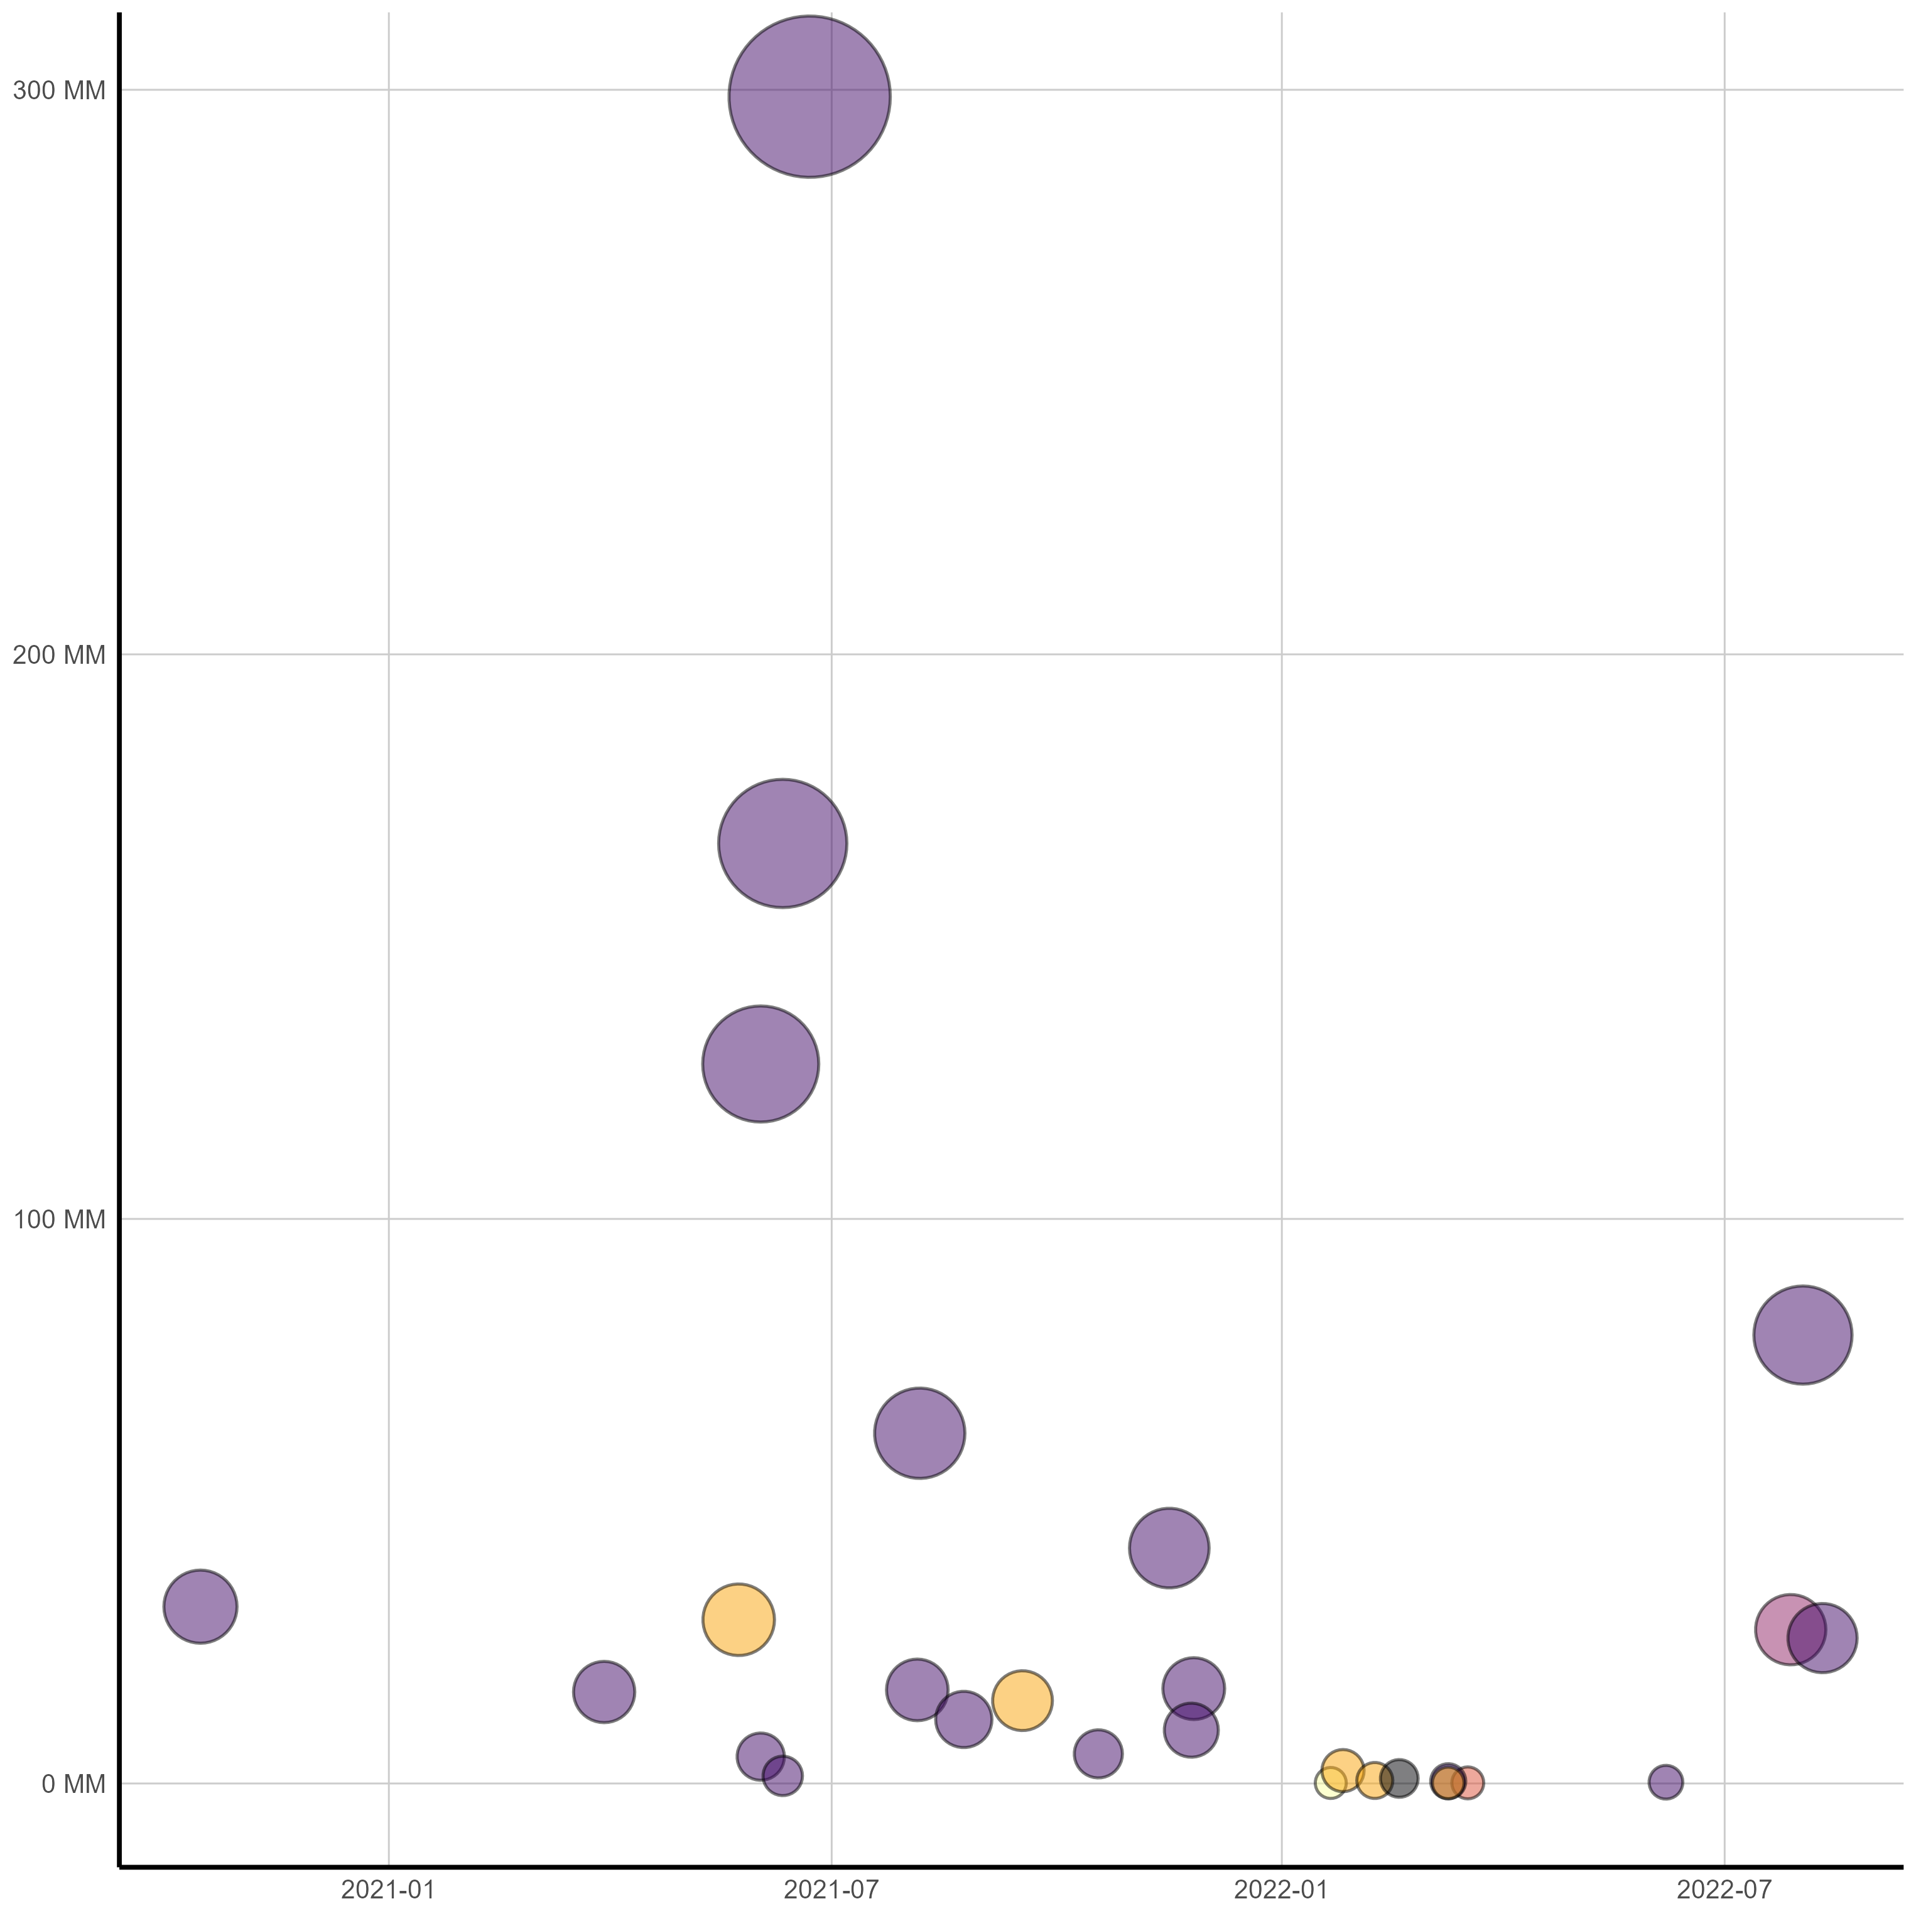

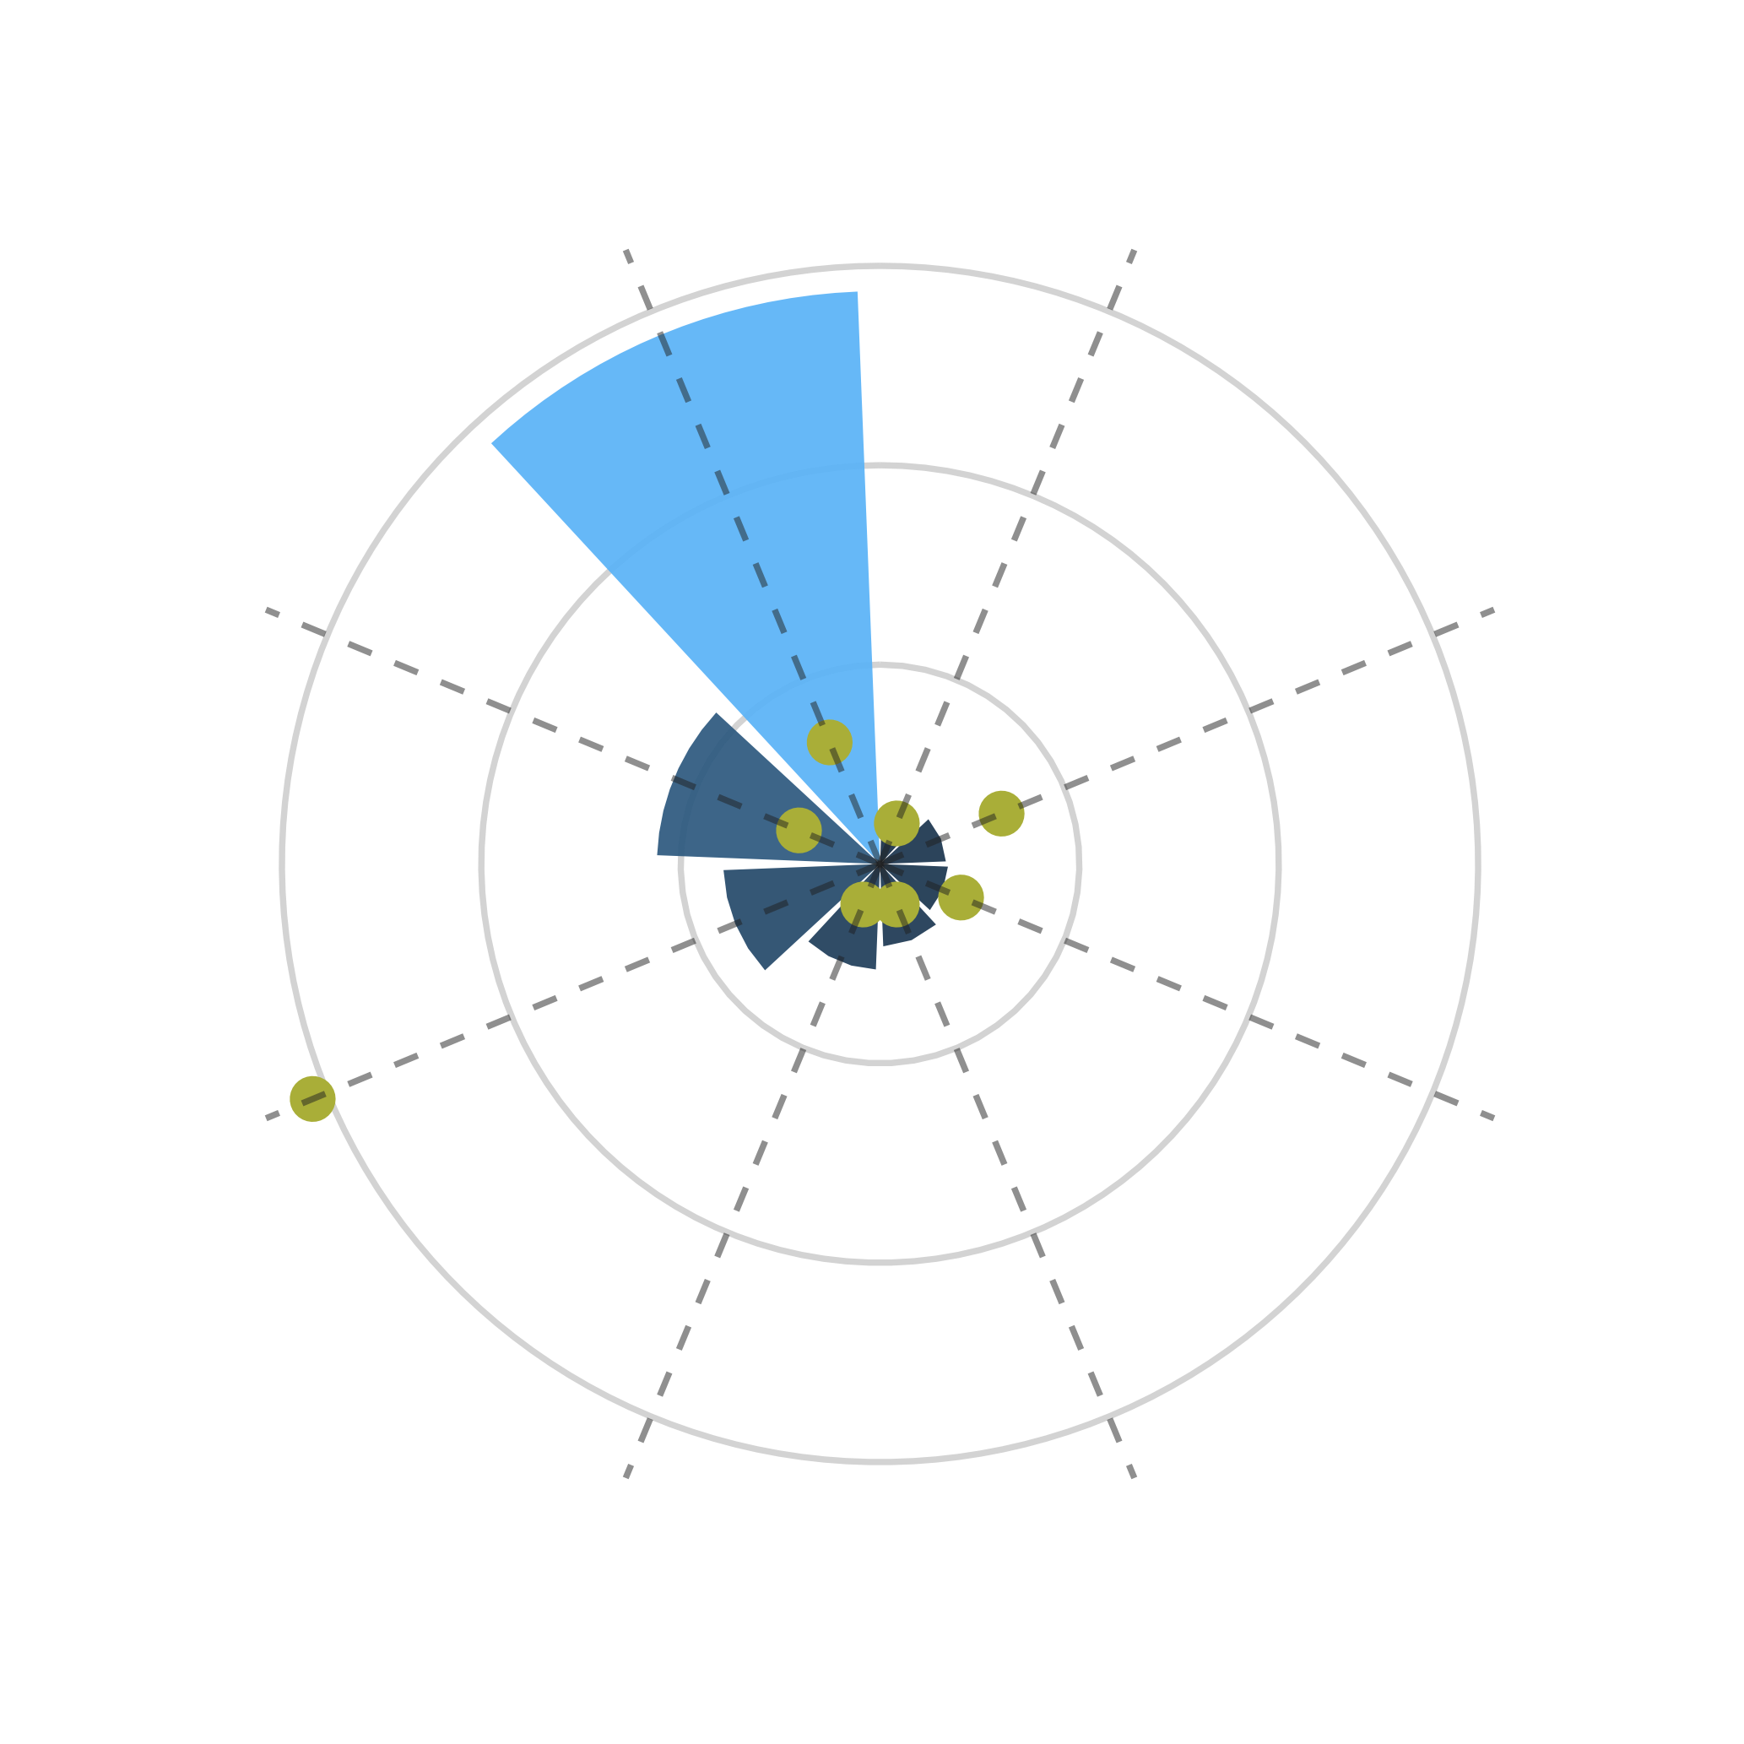












LAWSUITS AGAINST BURITIRAMA
R2C HAS BEEN CONTACTING LAWYERS OF BURITIRAMA’S MAIN CREDITORS
LAWSUITS AGAINST BURITIRAMA (BRL MM)
LAWSUITS AGAINST BURITIRAMA OVER TIME (BRL MM)
Intentionally Concealed
Intentionally Concealed
BRL 990MM
Santander
(Lefosse)
Buritirama
(Setoguti)
Em processos contra a Buritirama/Buritipar no TJSP
X
Execução de Título Extrajudicial
BRL 299MM | JUN/2021
LAWYERS
BRL 31MM
1 CASO
Citibank
(Sturzenegger e Cavalcante)
Buritirama
(Setoguti)
BRL 431MM
3 CASOS
X
Intentionally Concealed
Execução de Título Extrajudicial
BRL 167MM | JUN/2021
Santander
(Lefosse)
Buritirama
(Setoguti)
BRL 50MM
2 CASOS
X
BRL 168MM
3 CASOS
Execução de Título Extrajudicial
BRL 127MM | JUN/2021
Votorantim
(MWF)
Buritirama
(MAMG)
X
Execução de Título Extrajudicial
BRL 79MM | AGO/2022
Itaú
(WZ)
Buritirama
(Setoguti)
X
Execução de Título Extrajudicial
BRL 62MM | AGO/2021
MSP (P. Brito)
(Chucri)
Buritirama
(Fonseca Brasil)
OUTROS
Entersa
(Fonseca Brasil)
Buritirama
(Camilo Advog.)
X
BRL 118MM
14 CASOS
X
Execução de Título Extrajudicial
BRL 41MM | NOV/2021
BRL 51MM
2 CASOS
Execução de Título Extrajudicial
BRL 31MM | OUT/2020
VLI
(Tolentino)
Buritirama
(Camilo Advog.)
X
Steinweg
(CSA)
Buritirama
(-)
Valor Total (BRL)
Reajuste Prestações
BRL 29MM | MAI/2021
X
Falência
BRL 27MM | AGO/2022
# Créditos
CCB
(CMMM)
Buritirama
(-)
X
BRL 79MM
1 CASO
BRL 62MM
1 CASO
Execução de Título Extrajudicial
BRL 26MM | AGO/2022
Manganese Opportunity in Brazil | Strategic Data | September, 2023

Slide 21
BURITIRAMA’S FINANCIALS

Slide 22







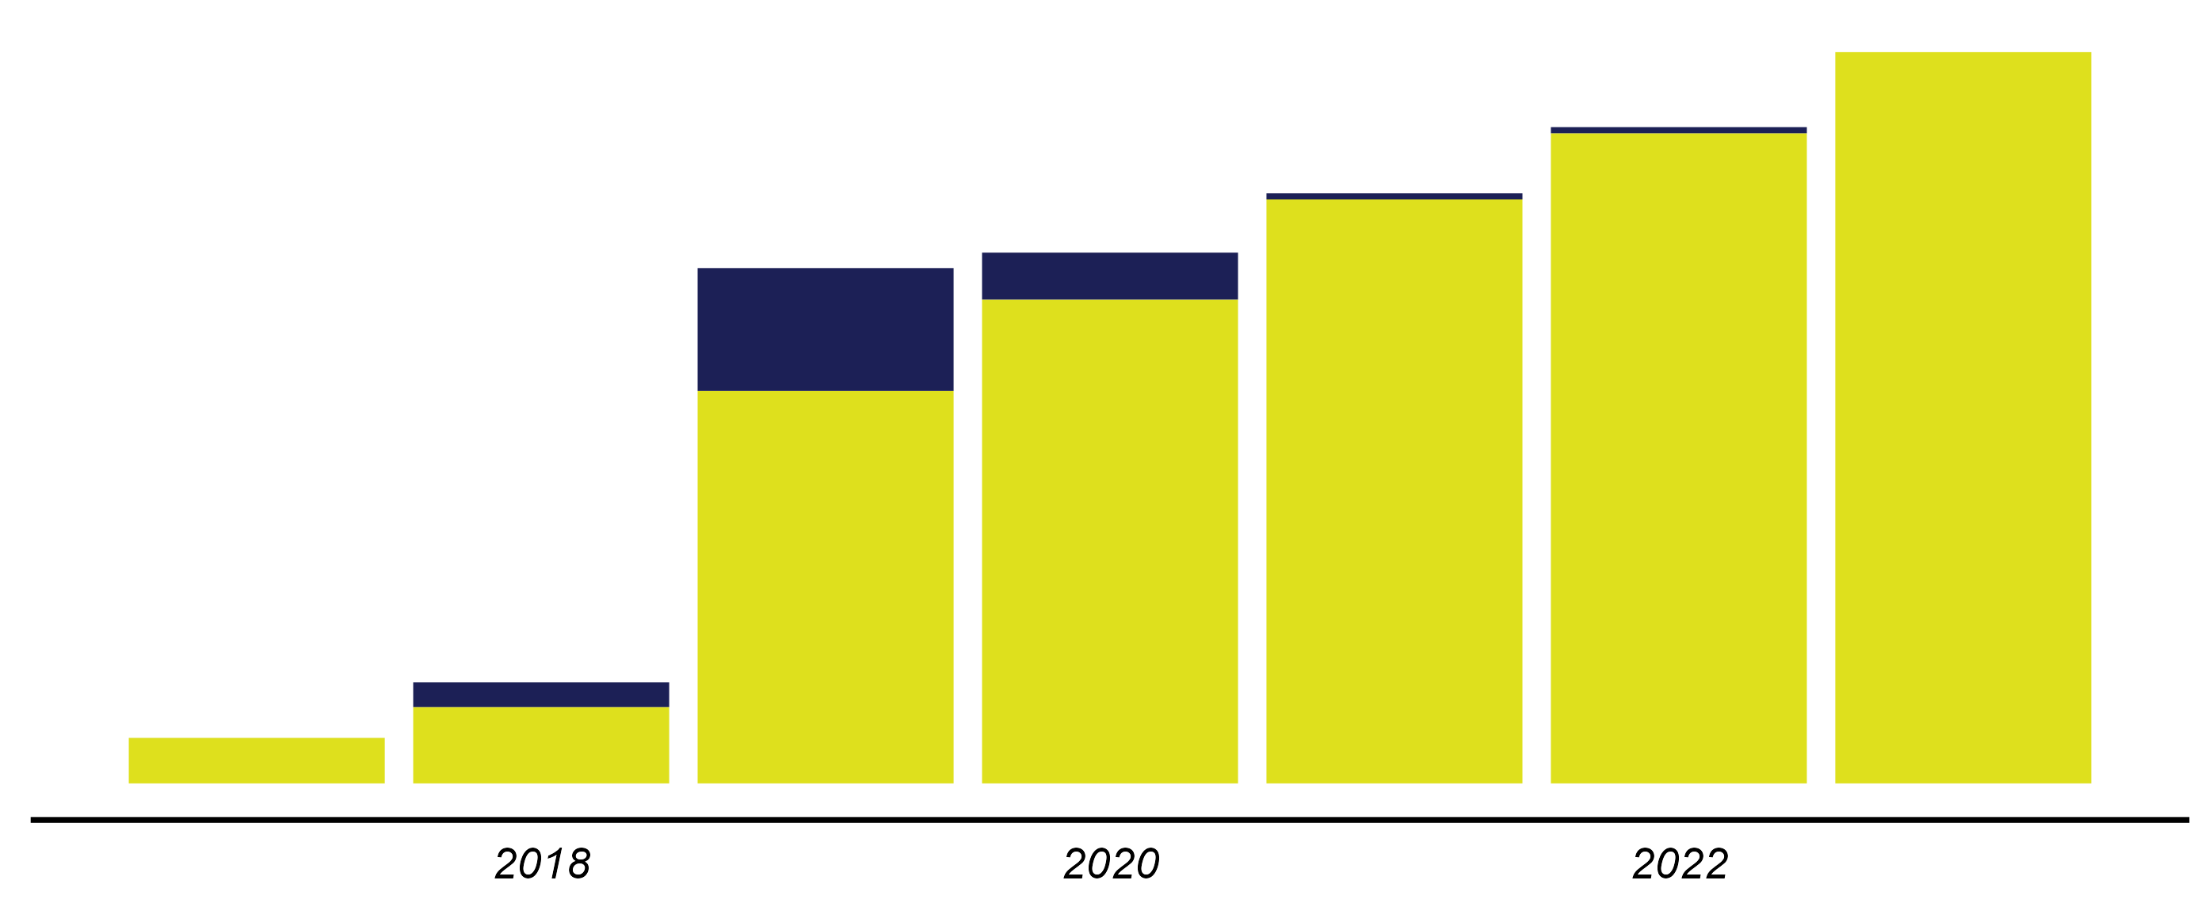
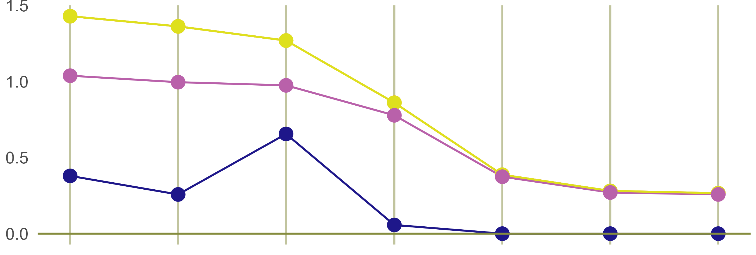
BALANCE SHEET
BALANCE SHEET(BRL MM)
Audited Financial Statements of Mineração Buritirama (2017-2020) and Unaudited Financial Statement of Mineração Buritirama (2021, 2022, and Jun/23)
2017
2018
2019
2020
2021
2022
2023
ASSETS
LIABILITIES
ASSETS
LIABILITIES
ASSETS
LIABILITIES
ASSETS
LIABILITIES
ASSETS
LIABILITIES
ASSETS
LIABILITIES
ASSETS
LIABILITIES
543
543
1,064
1,064
3,024
3,024
2,519
2,519
1,526
1,526
1,351
1,351
1,450
1,450
2,431
1,916
3,005
2,504
2,716
1,950
2,266
Intentionally Concealed
970
763
800
776
570
579
370
259
210
593
529
569
560
588
650
287
284
241
(1,065)
(1,469)
(1,651)
LIQUIDITY RATIOS
TOTAL DEBT (BRL MM)
Long Term
2,581
2,316
2,581
Short Term
2,083
2,295
1,818
1,873
2,061
433
165
1,708
Intentionally Concealed
Intentionally Concealed
1,385
Quick Liquidity
356
Overall Liquidity
161
270
Current Ratio
161
2017
2018
2019
2020
2021
2022
2023
2017
2018
2019
2020
2021
2022
2023
Manganese Opportunity in Brazil | Buritirama’s Financials | September, 2023

Slide 23



2023 BALANCE SHEET
ASSETS
BRL ‘000
LIABILITIES
BRL ‘000
BALANCE SHEET BREAKDOWN (BRL ‘000)
CURRENT ASSETS
CURRENT LIABILITIES
Cash & Equivalents
22
Suppliers
231,734
Accounts Receivable
3,018
Loans and Financing
2,580,902
Related Parties
614,736
Taxes & Contributions
180,998
3,005
Inventory
110,731
Others
11,386
Others
71,205
Total Current Liabilities
3,005,020
Total Current Assets
799,712
Related Parties
Loans & Financing
NON-CURRENT LIABILITIES
Intentionally Concealed
NON-CURRENT ASSETS
Loans and Financing
0
614,736
800
2,580,902
Recoverable Taxes
119,436
Provision for Litigation
Intentionally Concealed
Intentionally Concealed
8,617
Prepaid Expenses
Taxes & Contributions
Suppliers
Investments
354,316
Deferred Income Tax
0
Inventory
26,338
650
181,998
231,734
Judicial Deposits
54,905
Others
86,725
110,731
Recoverable
Taxes
Fixed Assets
115,224
Total Non-Current Liabilities
95,342
25,028
Judicial Deposits
Intangible Assets
5,920
54,905
Others
0
EQUITY
Investments
Fixed Assets
Capital
200,000
Investimentos
Recoverable Taxes
Total Non-Current Assets
649,801
354,316
Imobilizado
Intangível
354,316
119,436
115,224
Retained Earnings
(1,669,218)
186
(1,651)
Total Assets
1,449,513
Non-Controlling Interest
0
48
Others
(181,631)
ASSETS’ HIGHLIGHTS
LIABILITIES’ HIGHLIGHTS
14.9
Total Equity
(1,650,849)
Accounts receivable, which amounted to BRL 1 billion in 2020, decreased to only BRL 184 million in 2021 and further reduced to just BRL 3 million in 2023. This asset was related to an accounting practice at Buritirama known as "pre-billing". At the end of the year, an invoice for an excessive amount was issued by the main client for shipments that were never made.
The BRL 615 million from related parties pertains to a loan agreement with the individual João Araújo, established in 2020.
Loans and financing are mostly agreements for Advance Payment for Export Contracts (ACC) and Property, Plant, and Equipment (PPE) with annual interest rates ranging from 3.8% to 6.7%. Most of them have been secured by João Araújo.
Total Liabilities
3,100,362
Total Liabilities & Equity
1,449,513
Intentionally Concealed
Intentionally Concealed
Capital Social
38.5
Manganese Opportunity in Brazil | Buritirama’s Financials | September, 2023

Slide 24
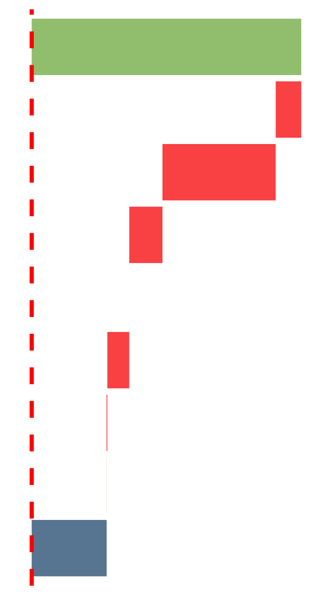





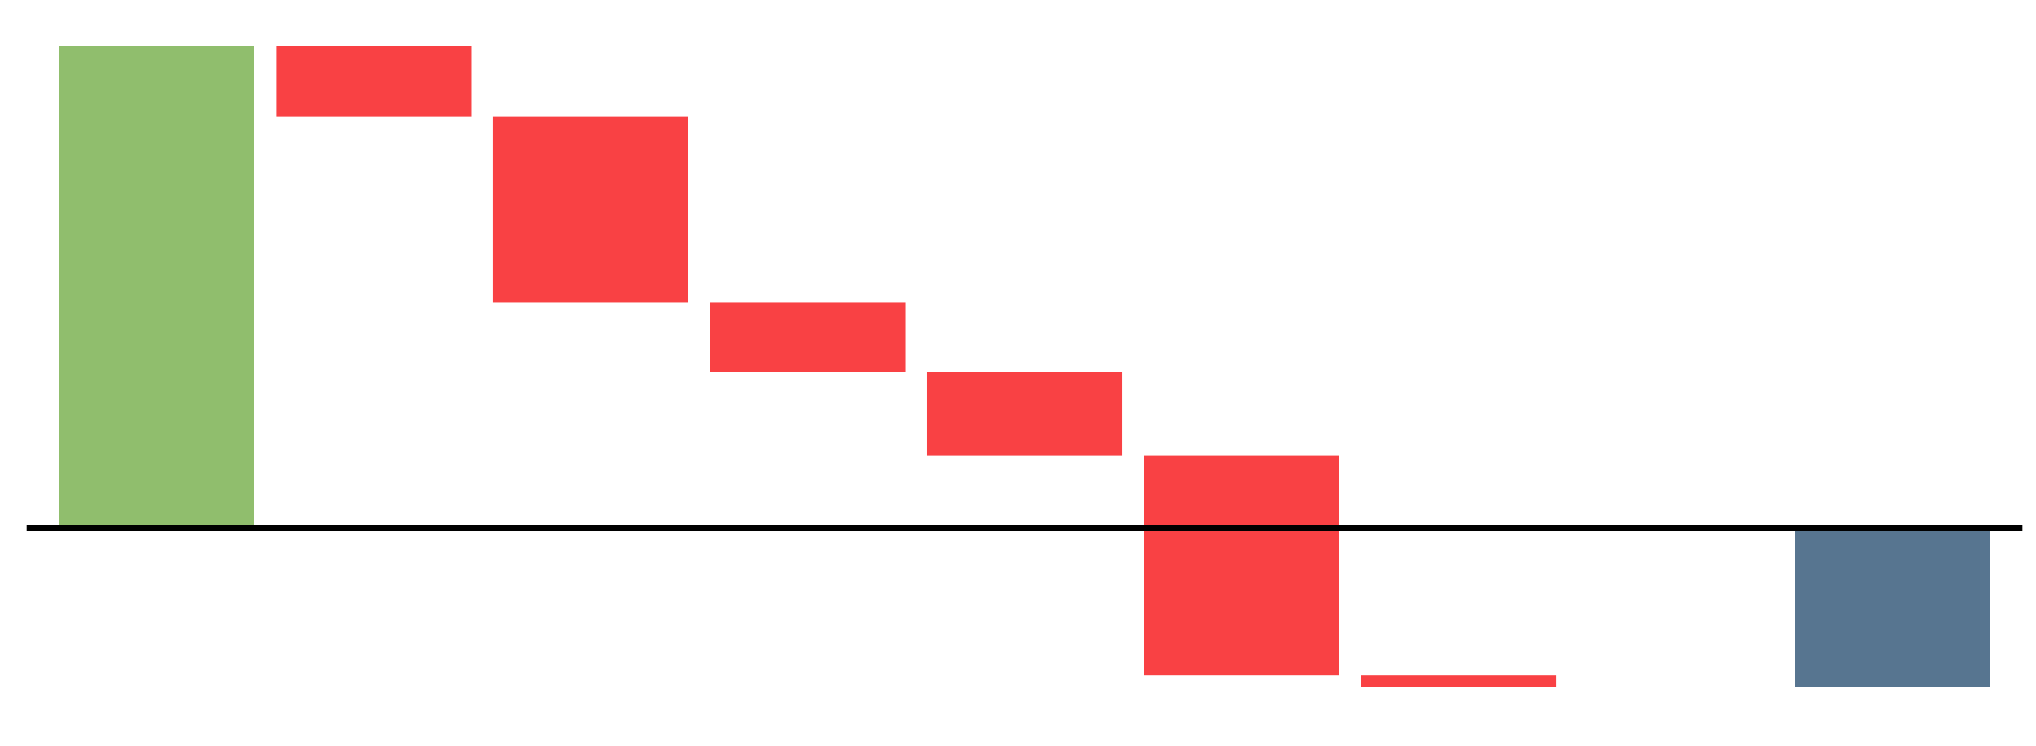
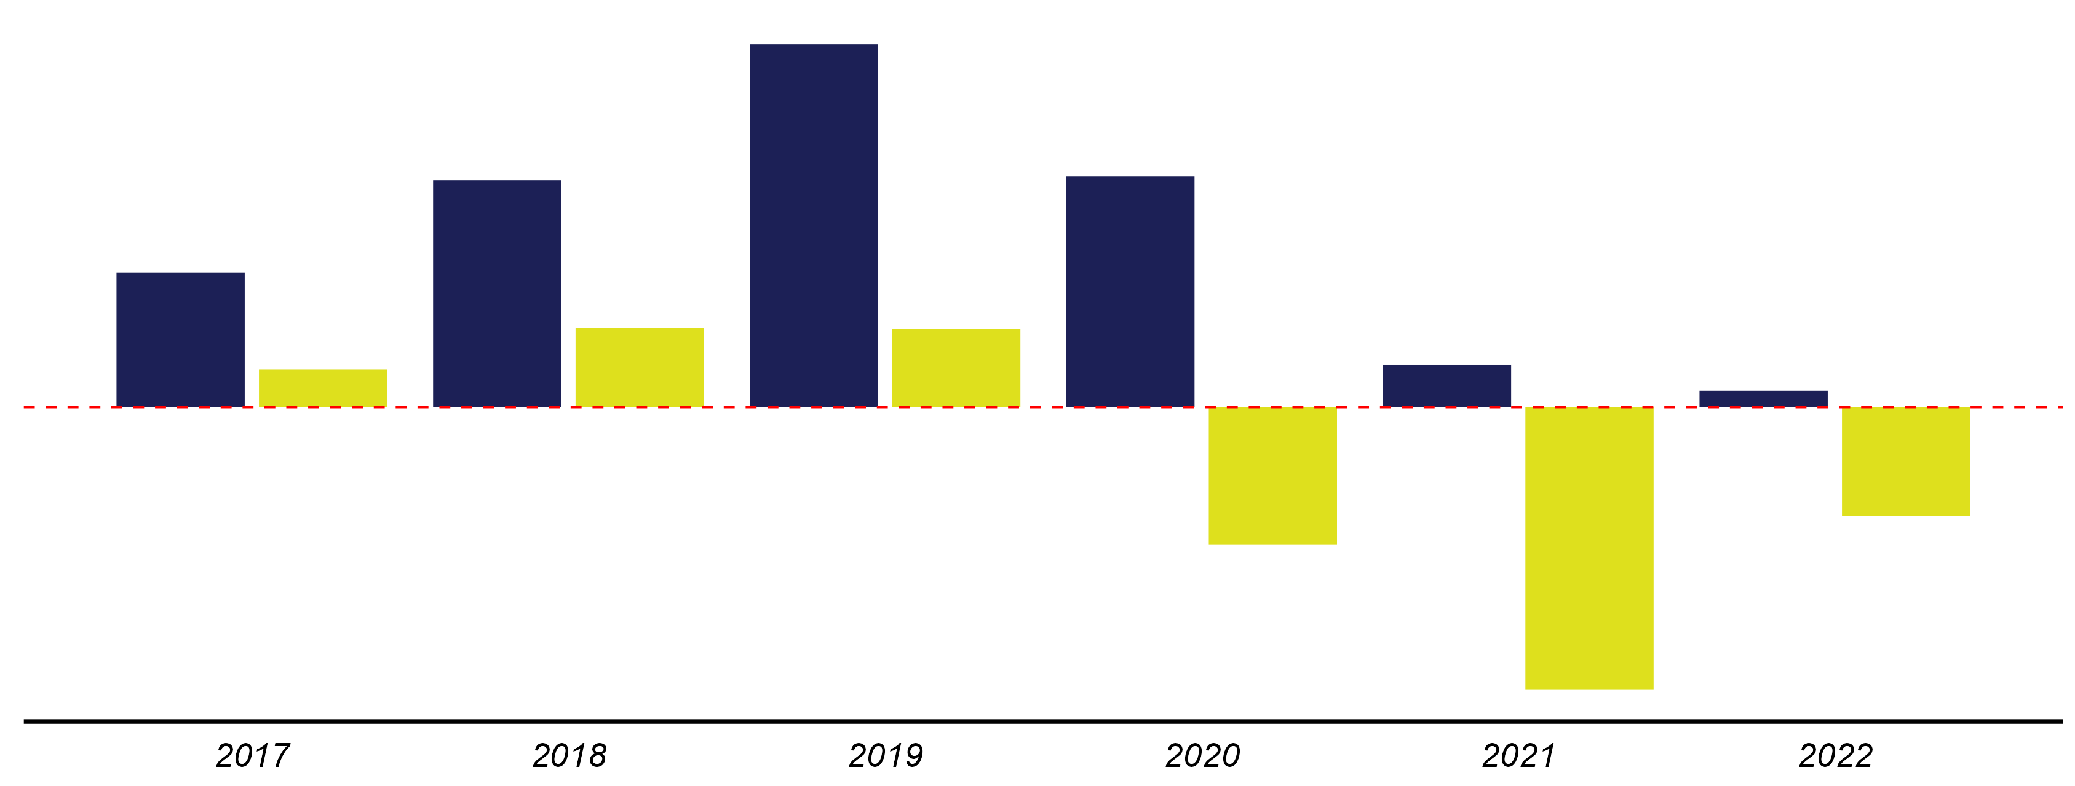
INCOME STATEMENT
INCOME STATEMENT (BRL MM)
Data: Audited Financial Statements of Mineração Buritirama (2017-2020) and Unaudited Financial Statements of Mineração Buritirama (2021 and 2022)
2017
2018
2019
2020
2021
2022
Net Revenue
498.1
841.1
1,344.8
854.6
155.6
60.3
Cost of Goods Sold
(47.2)
(479.4)
(194.5)
(146.6)
(62.5)
(19.6)
Selling Expenses
(209.2)
(298.8)
(571.3)
(303.1)
(57.7)
(8.4)
(34.3)
General and Administrative Expenses
(82.8)
Intentionally Concealed
(61.4)
(33.6)
(300.8)
(31.9)
Non-Operating Expenses
-
-
-
-
(620.2)
(27.6)
Financial Result
(40.5)
(34.6)
(277.3)
(601.3)
(427.6)
(379.2)
Income Tax
(1.4)
(52.2)
(29.0)
(14.1)
(0.1)
2.7
Equity in Earnings of Affiliates
(0.2)
-
(0.4)
-
-
-
138.5
(511.4)
(1,046.8)
Net Profit
138.5
293.4
288.8
(403.7)
HISTORICAL NET REVENUE AND NET PROFIT (BRL MM)
BREAKDOWN OF ACCUMULATED NET PROFIT BETWEEN 2017 AND 2022 (BRL MM)
Net Revenue
1,344.8
117.3
3,754
(549.8)
Net Profit
113.1
80.5
85.3
Intentionally Concealed
841.1
854.6
(1,448.5)
498.1
(544.8)
Intentionally Concealed
138.5
293.4
288.7
155.6
(647.8)
60.3
(403.7)
(1,710.4)
(94.2)
153.3
(0.1)
(1,241.2)
(511.4)
(1,046.8)
Cost of Goods Sold
Selling Expenses
General and Administratve Expenses
Non-Operating Expenses
Financial Result
Income Tax
Equity in Earnings of Affiliates
Net Profit
Net Revenue
Manganese Opportunity in Brazil | Buritirama’s Financials | September, 2023

Slide 25





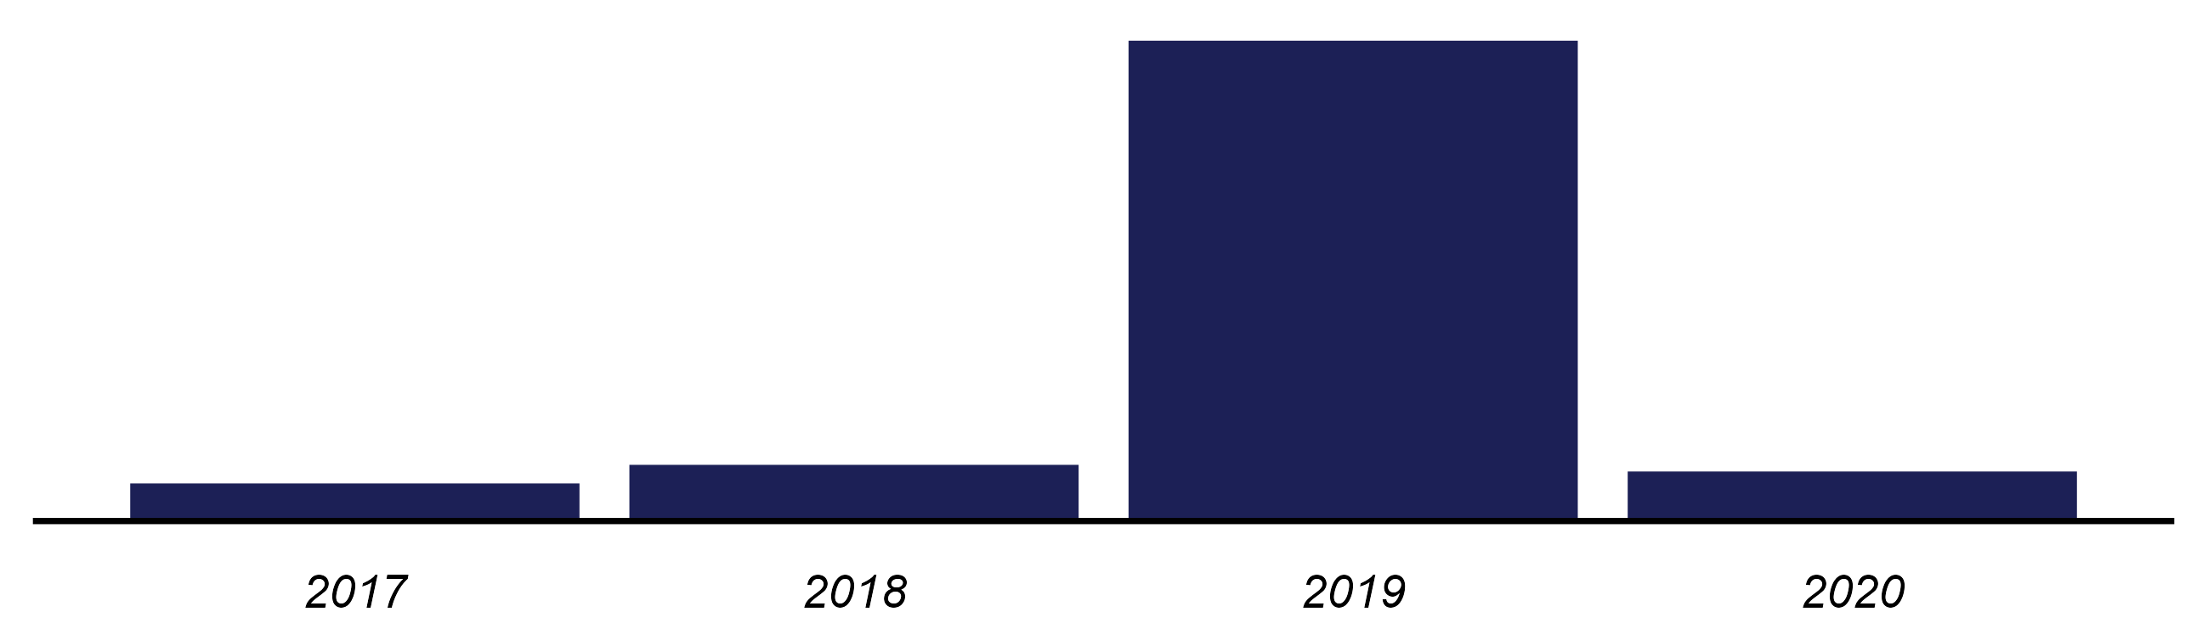




CASH FLOW
CHANGE IN CASH (BRL MM)
Data: Audited Financial Statements of Mineração Buritirama (2017-2020)
2017
2018
2019
2020
Accumulated
Operating Cash Flow
44.0
170.2
145.8
(326.4)
33.7
Intentionally Concealed
Investment Cash Flow
(58.2)
(60.1)
(554.3)
83.3
(589.3)
Financing Cash Flow
(80.4)
(61.5)
1,517.2
(883.0)
492.3
Change in Cash
(94.5)
48.7
1,108.7
(1,126.1)
(63.3)
HISTORICAL CASH HOLDINGS (BRL MM, 31-dez)
OPERATING CASH FLOW BREAKDOWN FROM 2017 TO 2020 (BRL MM)
1,255.6
78.0
64.5
30.4
21.0
209.3
(10.1)
(43.6)
(60.7)
(256.8)
Intentionally Concealed
383.0
Intentionally Concealed
611.8
98.2
146.9
129.5
(993.2)
33.7
Non-Cash Items Adjustment
Suppliers
Net Profit
Taxes & Contributions
Income Tax
Depreciation and Amortization
Salaries and Social Charges
Recoverable Taxes
Other Assets
Other Obligations
Others
Accounts Receivable
Operating Cash Flow
CUMULATIVE CHANGE IN CASH (BRL MM, 2017 - 2020)
33.7
INVESTMENT CASH FLOW (BRL MM, 2017 - 2020)
FINANCING CASH FLOW (BRL MM, 2017 - 2020)
492.3
(63.3)
4.9
145.2
3.8
2,896.9
(185.7)
Intentionally Concealed
(556.7)
Intentionally Concealed
(590.4)
(238.5)
(1,177.5)
492.3
(589.3)
(355.7)
(589.3)
Financing Cash Flow
Operating Cash Flow
Investment Cash Flow
Financing Cash Flow
Change in Cash
Others
PPE and Intangible Assets Acquisitions
Investments in Stock Market
Investment Cash Flow
Debt and Financing Raise
Capital Raise
Dividend Payments
Related Parties
Debt and Financing Payments
Others
Manganese Opportunity in Brazil | Buritirama’s Financials | September, 2023

Slide 26
Rua dos Pinheiros, 498
14th floor, office 141
Pinheiros, São Paulo, SP
05422-000
+ 55 11 3372-3699

